Slide 1

ENGR1000: Embedded Machine Learning
Caiwen Ding
Assistant Professor
Department of Computer Science & Engineering
University of Connecticut

Slide 2
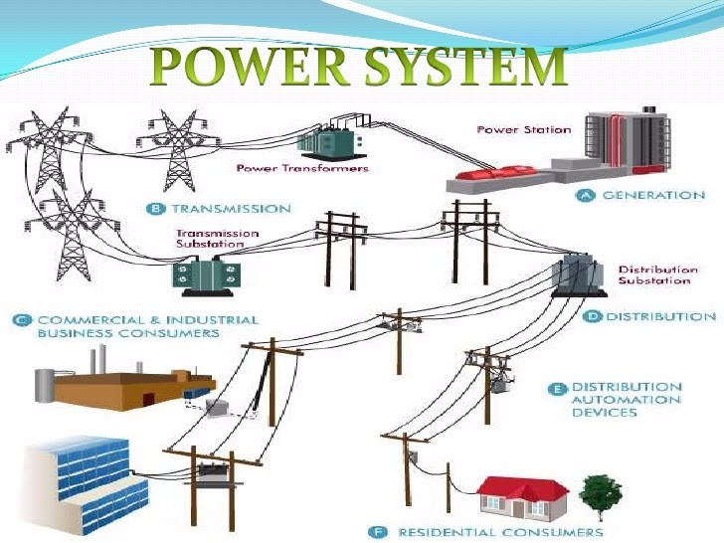
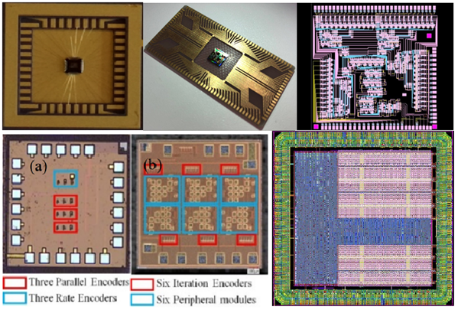
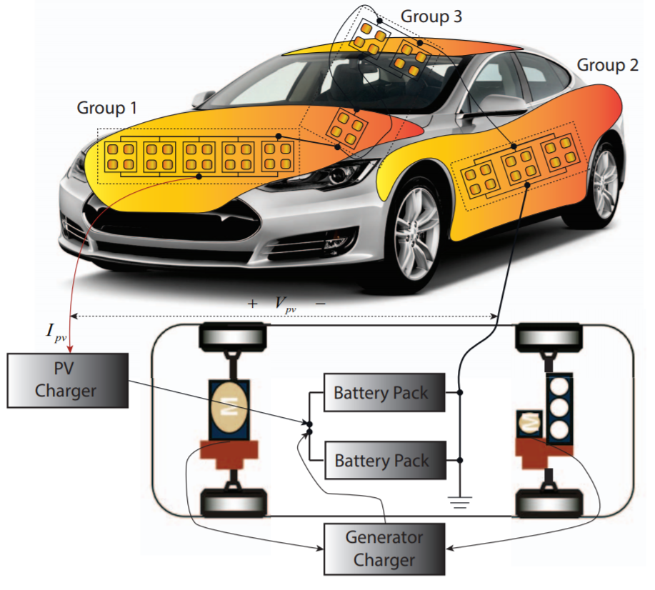
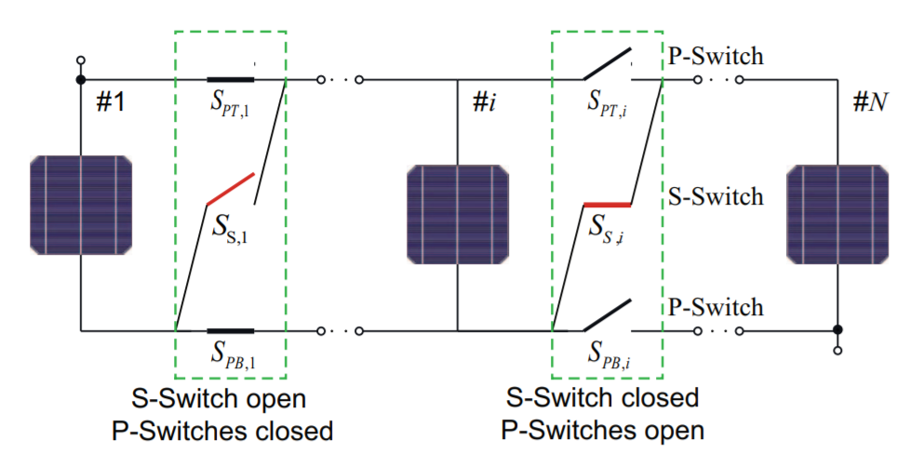
About me
How I got into my research field
Undergraduate: Power system;
Graduate: Energy Harvesting, Electronic design automation (EDA), (Syracuse Univ.)
http://elecengworld1.blogspot.com.es/2016/03/power-system-generationtransmissionand_9.html

Slide 3
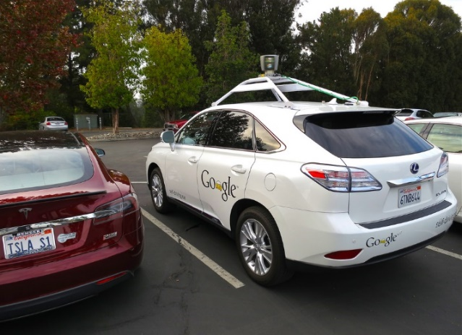

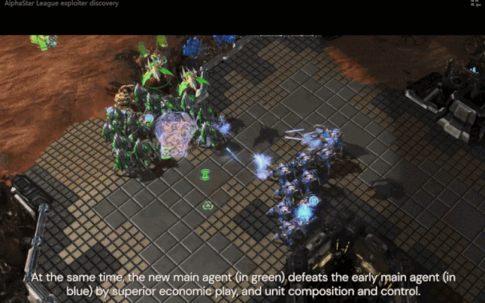
About me
How I got into my research field
2016-2018: Machine Learning (Efficient ML system) (Syracuse Univ.)
2018-2019: Machine Learning (Efficient ML system) (Northeastern Univ.)
2019-2020: Machine Learning at UConn
Self-Driving
Object Detection
Speech Recognition
PASCAL VOC
Machine Learning is Everywhere
AlphaStar playing StarCraft
Source: DeepMind
Healthcare
Image credits to Brother UK.
Notes:
Deep learning is everywhere today. It’s been used in self-driving cars to process data and make informed decisions. It’s been used in speech recognition in our phones, smart watches, and smart home devices such as Amazon Echo dot. It’s been used in object detection for face detection, people counting, visual search engine. It’s been used in healthcare. For example, Medical image analysis using deep learning can be better than trained radiologists at reading x-rays. Recently, Alphastar playing Starcraft game program, deep learning beats the profs.
TI8 champions OG 2-0

Slide 4
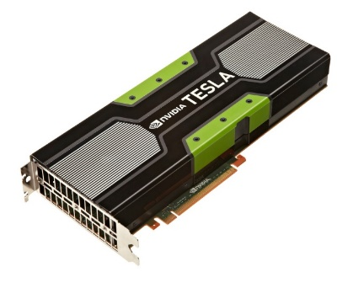
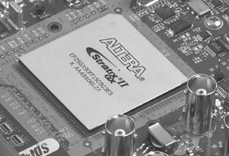
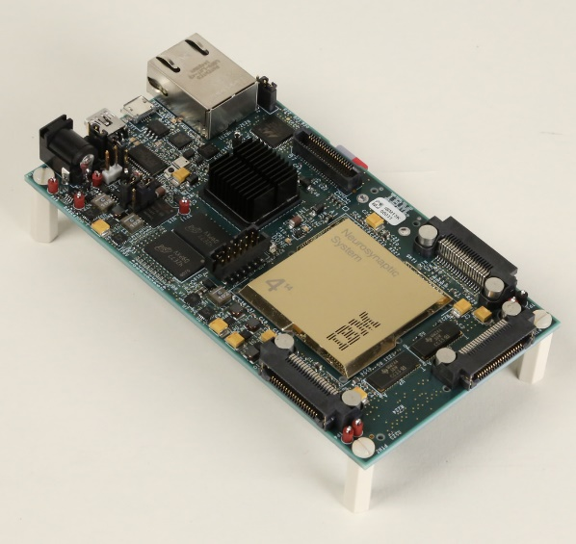
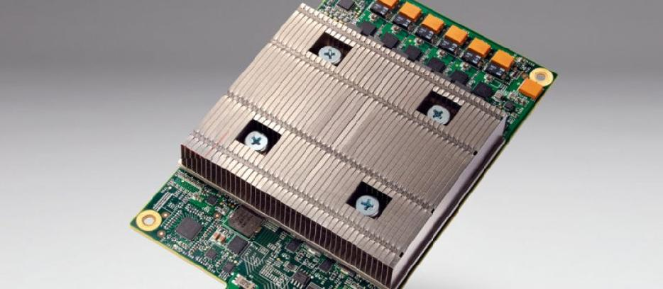
Deep Learning Hardware- Related to Comp Arch
graphics processing unit (GPU)
field-programmable gate array (FPGA)
Mobile Phone
Google TPU
IBM TrueNorth

Slide 5
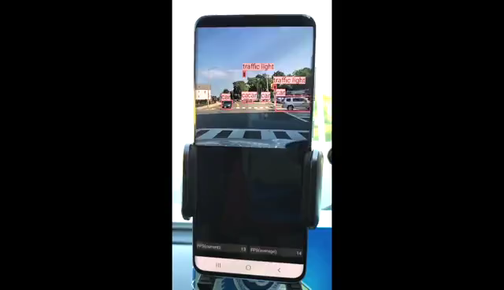
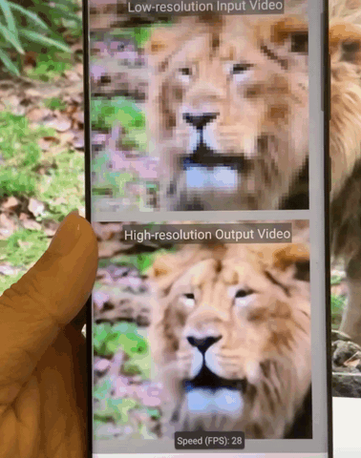
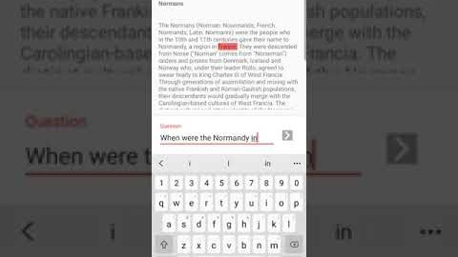
Demo- CoCoPIE Real-time AI on Mobile
Object Detection
https://www.cocopie.ai/
Super Resolution
https://www.youtube.com/channel/UCCKVDtg2eheRTEuqIJ5cD8A

Slide 6
Thank you!
caiwen.ding@uconn.edu

